Slide 1
CONTRACTED PELVIS
Dr Shanthi Serene Sylum V
Professor and Head
Dept. Obstetrics and Gynaecology
SKHMC Kulasekharam

Slide 2
DEFINITION
ANATOMICAL DEFINITION:
Contracted pelvis is defined as one where the essential diameters of one or more planes are shortened by 0.5cm.
OBSTETRICAL DEFINITION :
Alteration in the size or shape of the pelvis of sufficient degree as to alter the normal mechanism of labour in an average size baby.

Slide 3
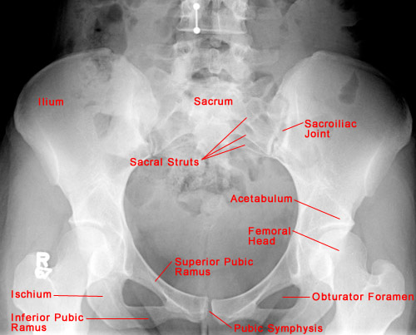

Slide 4
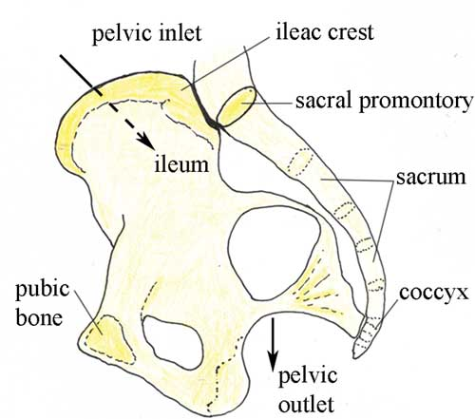
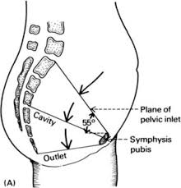
PELVIC INLET AND OUTLET

Slide 5
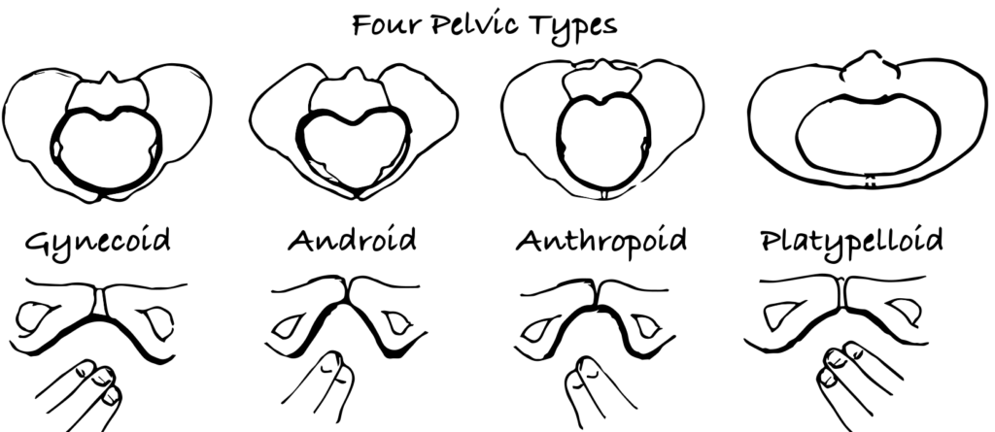
TYPES OF CONTRACTED PELVIS
Gynecoid
Anthropoid
Android
Platypelloid

Slide 7
ETIOLOGY
Nutritional and environmental defects
Diseases or injuries affecting pelvic bones
Development defects – Naegele’s pelvis, Rachitic pelvis, high or low assimilation pelvis

Slide 8
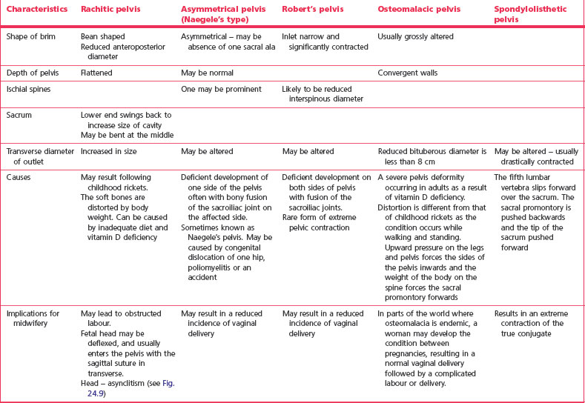

Slide 9
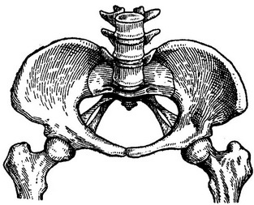
RACHITIC PELVIS
Rickets is predominantely a disease of early childhood when the bones gets soft and unossified. In childhood changes occur in the bony pelvis due to weight bearing classic changes in the pelvic bones.

Slide 10
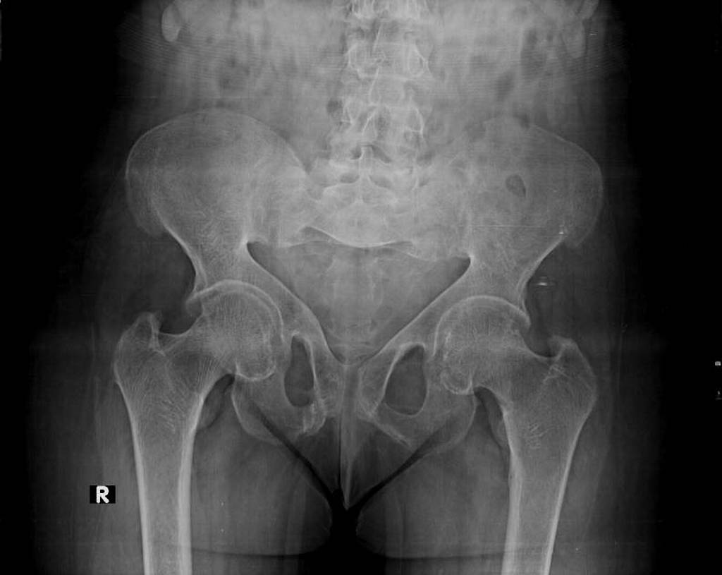
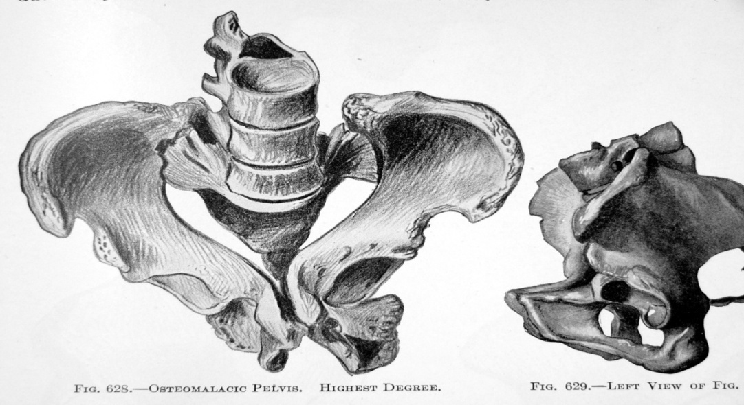
OSTEOMALACIC PELVIS
The deformity is caused by softening of the pubic bones due to deficiency of CA AND Vitamin D and lack of exposure to sunrays.It usually affects women after they have reached maturity.

Slide 11
ASSYMETRICAL OR OBLIGUELY CONTRACTED PELVIS
Naegele’s Pelvis
Scolliotic Pelvis
Due To Disease Affecting One Hip Or Sacroiliac Joint
Tumours Or Fracture Affecting The Pelvic Bones

Slide 12
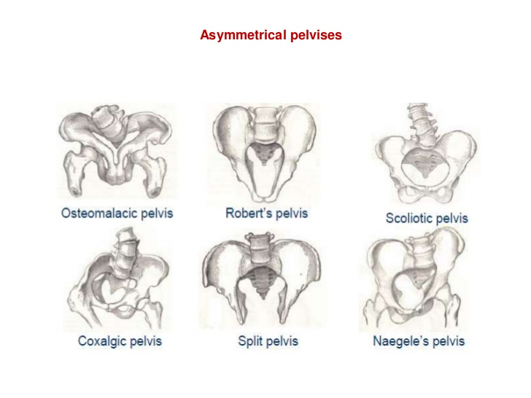

Slide 13
NAEGELE’S PELVIS
It is produced due to arrested development of one alarm of the sacrum .
It may be congenital or acquired.
Pelvis is obliquely contracted at all levels more in the outet.
Iliopectinal line on the affected side is almost straight.
Method of delivery by cesarean.

Slide 14
Naegele’s Pelvis

Slide 15
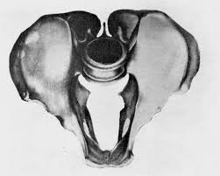
ROBERT’S PELVIS
Transversely contracted pelvis.
Ala of both the sides are absent and the sacrum is fused with the innominate bones

Slide 16
KYPHOTIC PELVIS
It is secondary to the kyphotic changes of the vertebral column either by tuberculosis or rickets
The sacrum is tilted backwards in the upper part and forwards in the lower part.
The AP diameter of the inlet is increased ,but is diminished at the outlet.
Pubic angle is narrow- extreme funneling of the pelvis.
Abdomen becomes pedunculated.
Cesarean is the ideal mode of delivery.

Slide 17
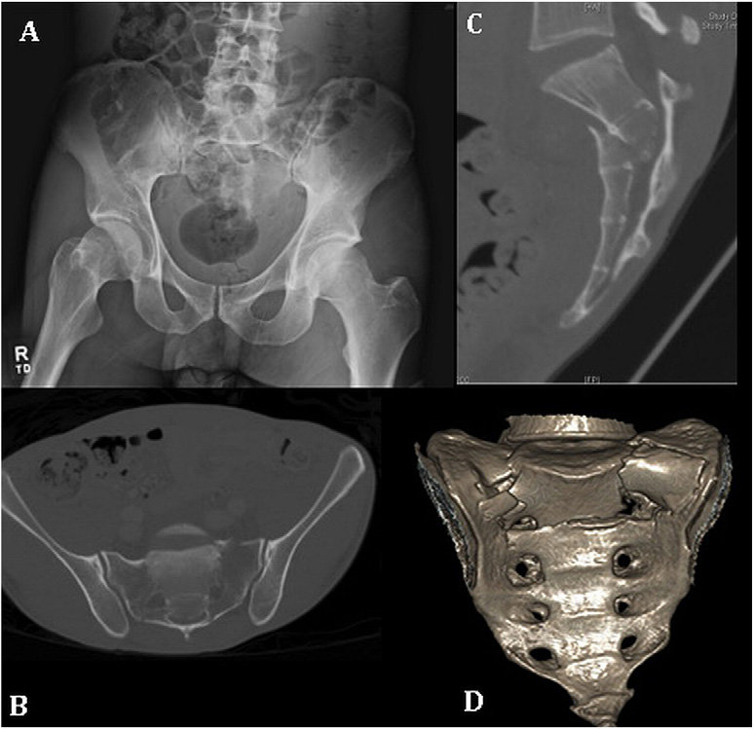

Slide 18
Thank you

